Slide 1


Slide 2

INTRODUCTION TO MODERN JAVASCRIPT

Slide 3
What Is JavaScript?
JavaScript is a dynamically -typed, interpreted (on the fly compiled) programming language with object-oriented capabilities that allows us to build interactive web pages.

Slide 4
Dynamically Typed ?
We don’t have to mention the data type of the variable while declaring it.
It is assumed by JS automatically at run time .

Slide 5
Interpreted ?( On the fly compiled?)
Not pre-compiled like C/C++ , instead it is interpreted and executed at run time .
Also there is a Compiler which JS uses to optimize our code fragments so as to get faster execution.

Slide 6
Object Oriented Capabilities ?
JS is not a full fledged Object Oriented Language, rather it uses some popular Object Oriented Features .
For example , it allows us to create function which can act as a class

Slide 7
Interactive Web Page ?
JS can respond to user actions like button clicks or mouse movements and make our web pages dynamic .
For example ,when the user clicks a button JS can display current time on the browser

Slide 8
Who Runs Our JavaScript Code ?
JavaScript code is handled by JavaScript Engine .
It interprets, compiles and executes our JavaScript code
Each browser has it’s own JavaScript Engine.

Slide 9
JS Engines Names
Browser | JavaScript Engine
Google Chrome | V8
Microsoft Edge | Chakra
FireFox | SpiderMonkey
Opera v 14+ | V8
Safari | JavaScriptCore (Nitro)

Slide 10
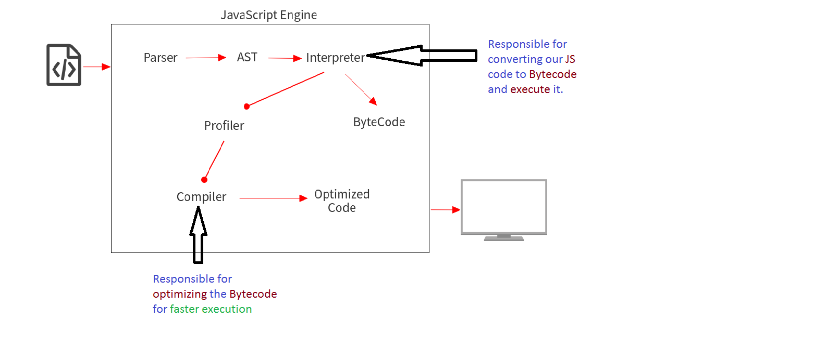
The JS Engine Components
.

Slide 11

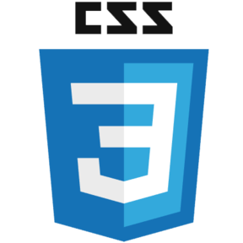

Relationship With Html And CSS
Core technology of web development
Commonly Used
Along with HTML and CSS, JavaScript is one of the core technology of web development.
JavaScript is most commonly used to provide interaction with web pages.

Slide 12


HTML : Content
JavaScript : Dynamic Effects
<p>Java is to JavaScript as Ham is to Hamster</p>.
Dynamic Effects means changing the content or behaviour of the page at run time.
For example , as the user moves his mouse over the text shown , it’s color can be changed using Java Script.
CSS : Styling
p { color : red; }

Slide 13



JavaScript In Today’s World
Client Side
Earlier JavaScript was a client side language and was limited only to browser
Server Side
What makes JavaScript possible on server side is Node Js
Desktop Apps
Using Eectron JS , now we can develop desktop apps with JS too
Mobile Apps
JavaScript frameworks like React Native and Ionic can be used to develop mobile apps for Android as well as iOS

Slide 14
What JavaScript Can Do In Browser?
Following are the tasks for which JavaScript is mainly used:
User Interaction
Form Validation
Image Swaps/Rollover

Slide 15
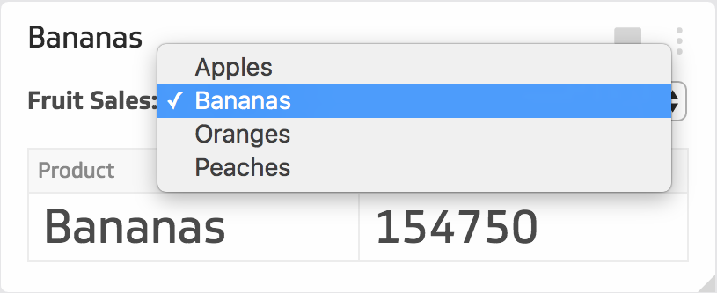
User Interaction
Sample: https://dr5hn.github.io/countries-states-cities-database/

Slide 16
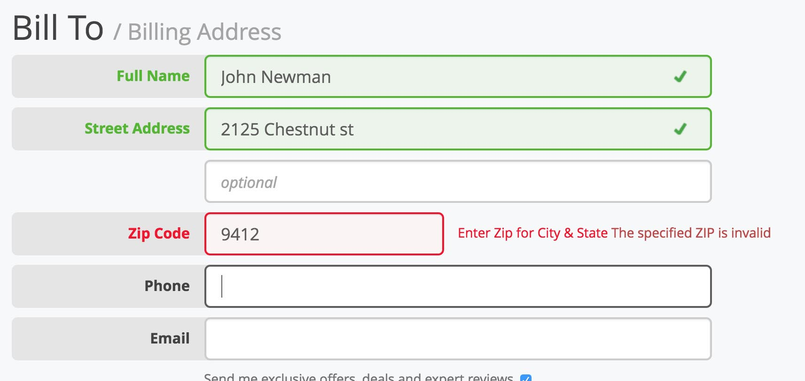
Form Validation

Slide 17
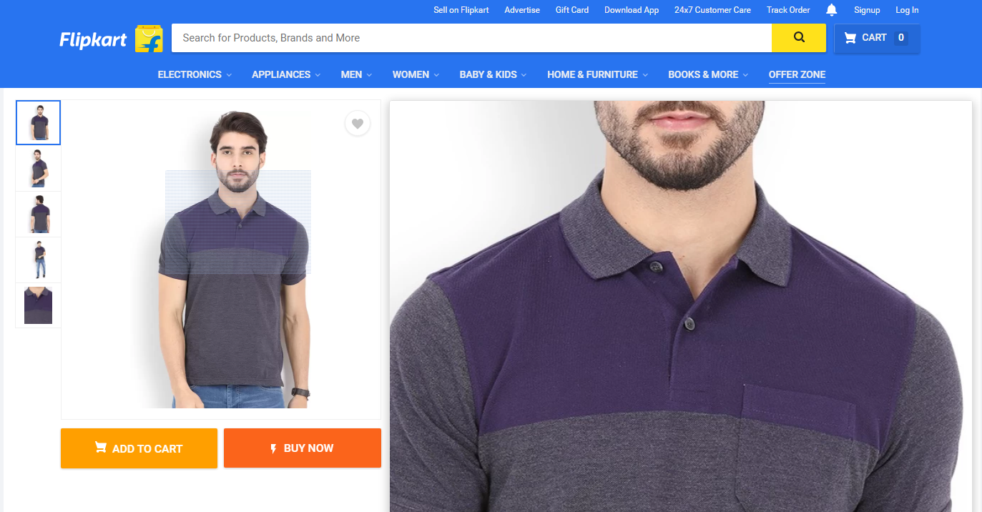
Image Roll Over

Slide 18

Image Swap

Slide 19
What Java Script(client side) Can’t Do ?
JavaScript cannot access Database(without AJAX or FetchAPI)
JavaScript cannot access files on client machine

Slide 20
Java V/s JavaScript
Java
JavaScript
Java was developed by Sun Microsystems and is a full fledged, standalone, object oriented language

JavaScript was created by Netscape and is a scripting language which is placed inside an HTML page and provides interactivity to the page.


Java is both a compiled as well as interpreted language.

JavaScript is mainly an interpreted language but with on the fly compilation

Java runs inside JVM.

JavaScript runs inside a host environment

Java is a statically typed language as it is compulsory to declare every variable’s data type.

JavaScript is a dynamically typed language as we do not have to declare data types of variables before using them.

Java has been designed with security as it’s top priority. Every thing in java runs under the control of JVM that handles execution of a Java code.

JavaScript is a much less secure language.

Slide 21
History Of JavaScript
Developed By
Latest Version
Brendan Eich
1.8.5
Original Name
First Version
Mocha, LiveScript
1.0
Company
Launching Year
Netscape
1996

Slide 22
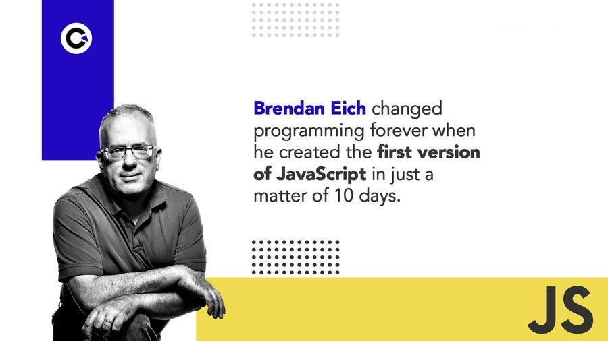
Version History Of JavaScript
1996
Brendan Eich made the first version of JavaScript and called it Mocha
Later it was named to LiveScript and then finally to JavaScript
Many similar languages appeared , for ex: Microsoft published an exact copy of JavaScript
and named it as JScript

Slide 23
Version History Of JavaScript
1997
Netscape submitted JavaScript for standardization to an organization called ECMA
ES1 (ECMAScript 1) became the first version of JavaScript language Standard.
ECMAScript : The language standard
JavaScript : The language in practice

Slide 24
Version History Of JavaScript
2009
ES5 (ECMAScript 5) was released with lot of new features.
2015
ES6/ES2015 (ECMAScript 2015) was released : The biggest update to the language ever!
ECMA decided to change to annual release cycle in order to ship less features per update.
Then 2016, 2017, 2018, 2019, 2020, 2021 and 2022 were the years for release of :
ECMAScript 2016 / ECMAScript 2017 / ECMAScript 2018 / ECMAScript 2019 / ECMAScript 2020 / ECMAScript 2021 / ECMAScript 2022

Slide 25
Which Version To Use ?
ES5
ES6 to ES2022
ES2023 . . .
Fully supported in all browsers.
Well supported in all modern browsers.
Some features are supported in modern browsers.
No support in older browsers.
Can use most features in production with transpiling through BABEL
(Converting to ES5).

Slide 26
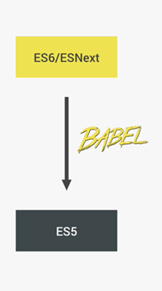
What Is Babel ?
Babel is a JavaScript transpiler that converts our Modern JavaScript into plain old ES5 JavaScript .
For example, classes, let , const , arrow function will be converted to function, var etc so that they can run in any browser (even the old ones).

Slide 27
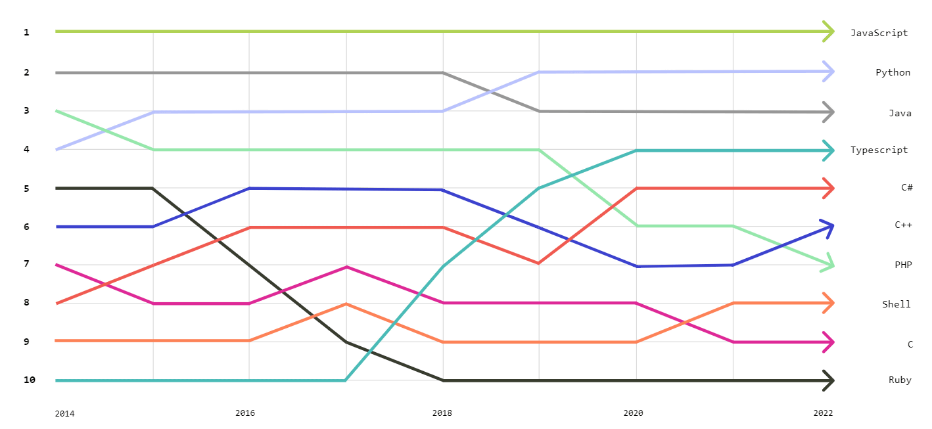
Where JS Stands Today ?
.
Courtesy : https://gigazine.net/gsc_news/en/20221117-github-top-programming-languages-2022/

